Slide 1
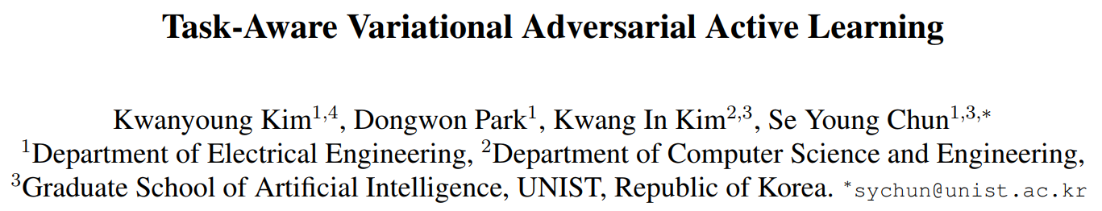
Published in Neural Networks
Jeonbuk National University
Multimedia Lab Under Prof. Park and Prof. Yoon
Mingle Xu
13 Jan, 2021

Slide 2
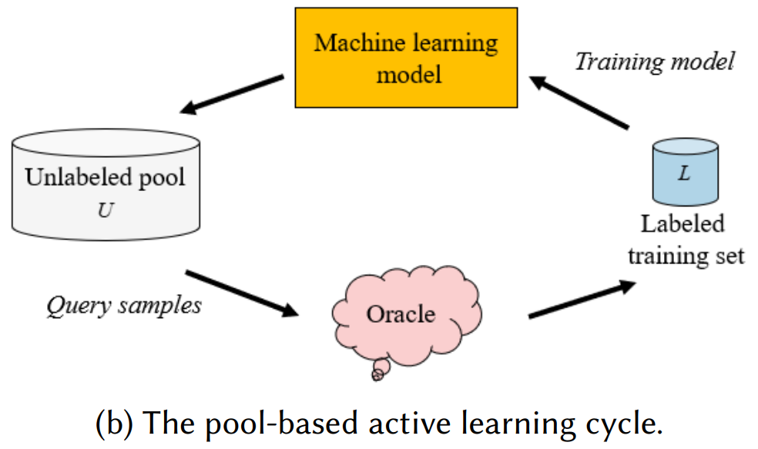
Background
Labeled data for deep learning.
Active learning: iteratively find the most informative samples to label from unlabeled data.

Slide 3
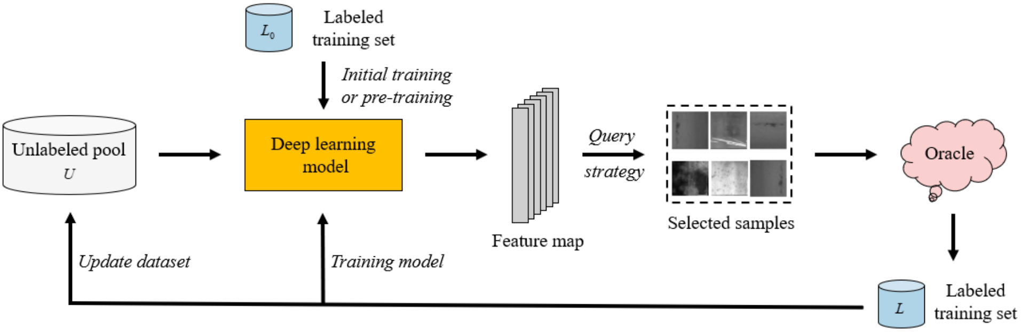
Background
Active learning and deep learning

Slide 4
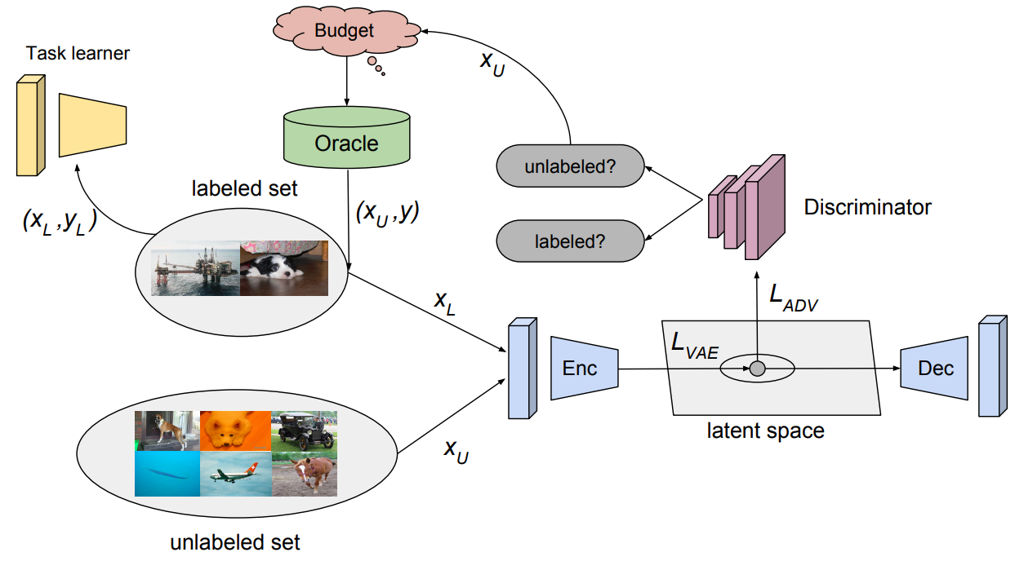
Background
Active learning: how to choose the most informative samples?
Uncertainty.
Learning it in an adversarial manner (ICCV 2019).
Task-aware
Task-agnostic

Slide 5
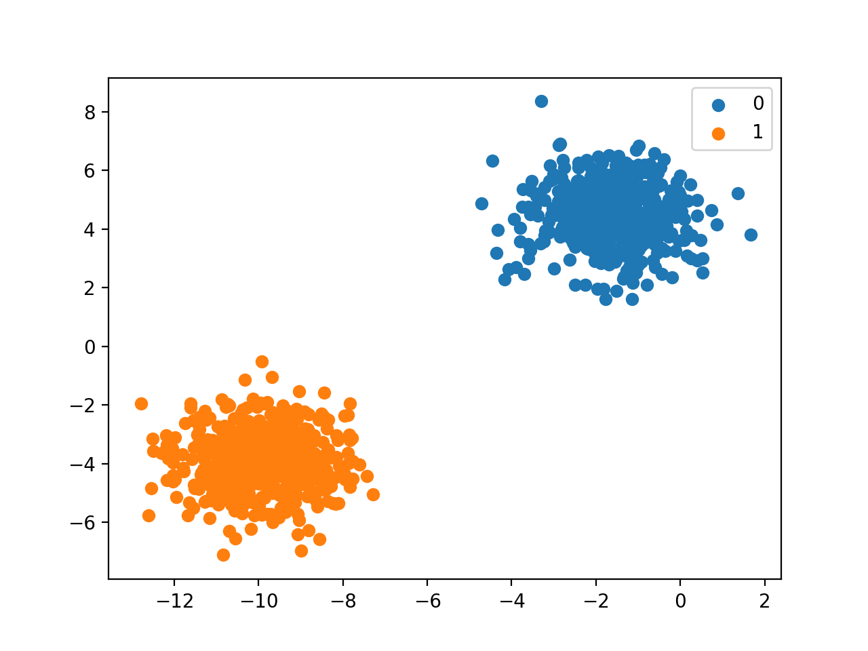

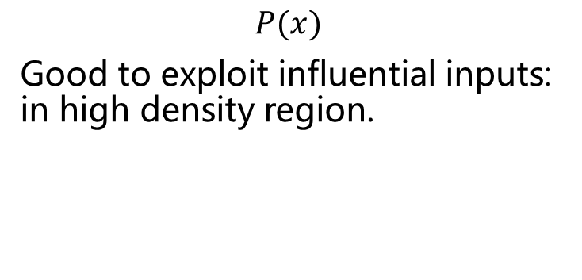

Introduction
$$𝒳→𝒴$$
Task-agnostic
Task-aware
$$P(x)$$
Good to exploit influential inputs: in high density region.
$$P(y|x)$$
Good to find difficult inputs: in vicinity of decision boundary.
Can we combine two advantages?

Slide 6
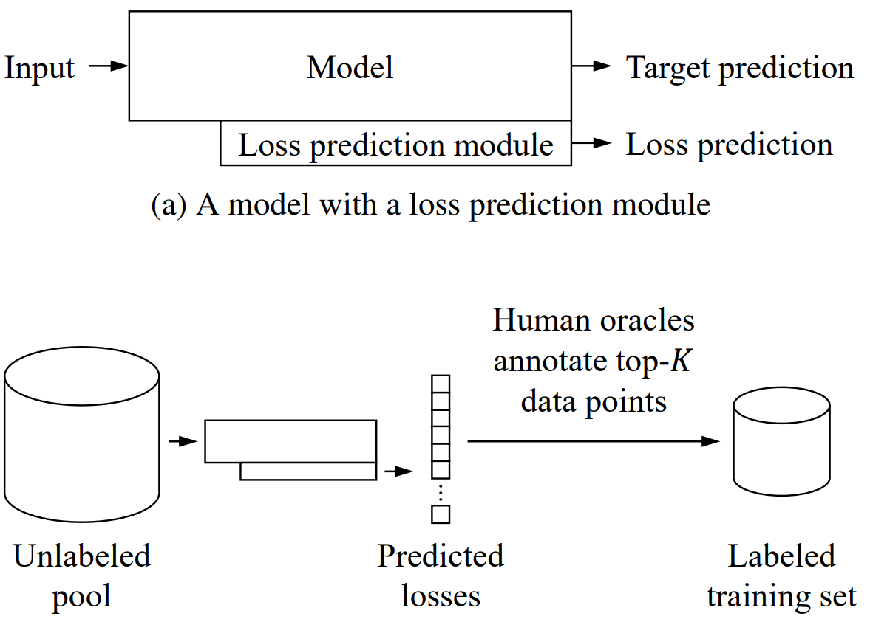
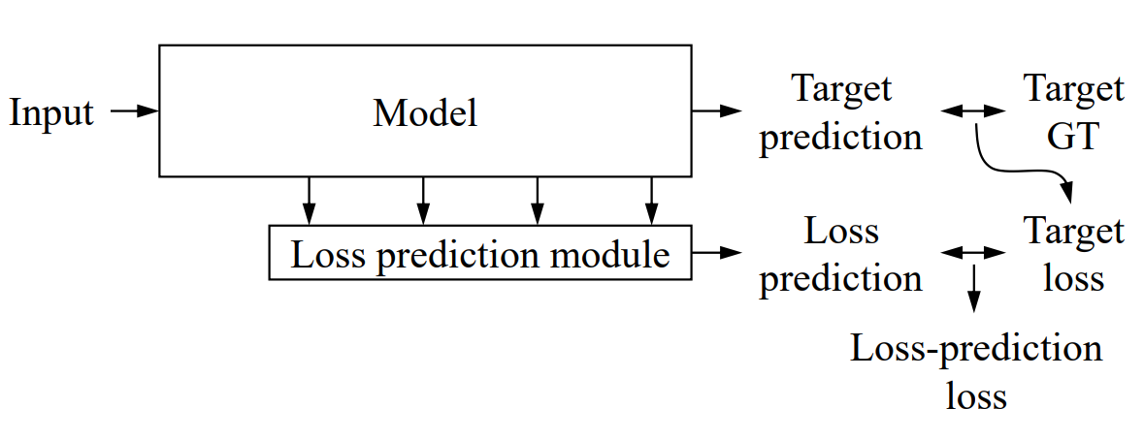

Background
Can we use a network to predict the loss? (CVPR 2019)
$$P(y|x)$$
Task-aware

Slide 7
Introduction
Can we combine two advantages?
$$𝒳→𝒴$$
Task-agnostic
Task-aware
$$P(x)$$
Good to exploit influential inputs: in high density region.
$$P(y|x)$$
Good to find difficult inputs: in vicinity of decision boundary.

Slide 8
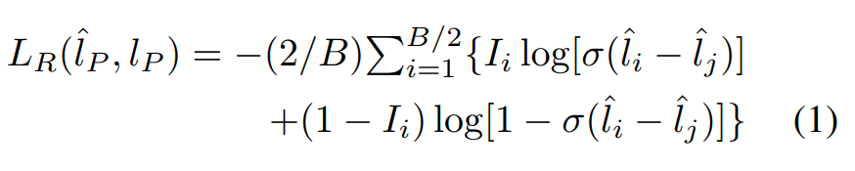

Proposed Method
From learning accurate loss to learning ranking loss (relative loss).
Relative comparison of target attributes are often easier to learn and predict;
Ranking is often sufficient to label.

Slide 9
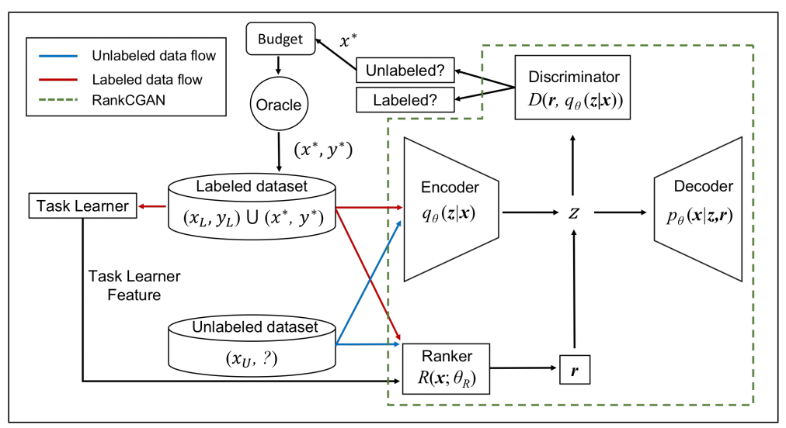
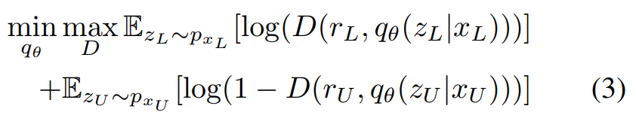
Proposed Method

Slide 10
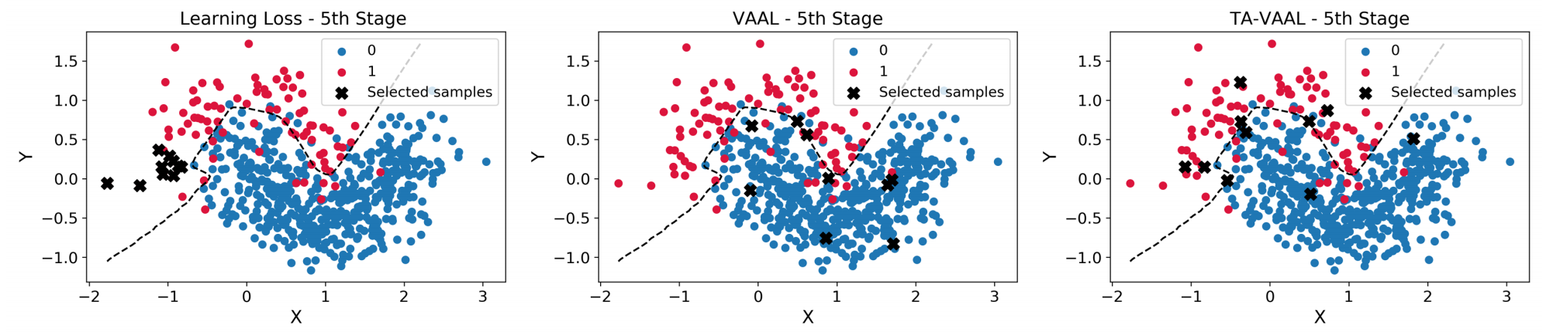
Experiments
Task-aware and task-agnostic
Difficult points and influential points

Slide 11
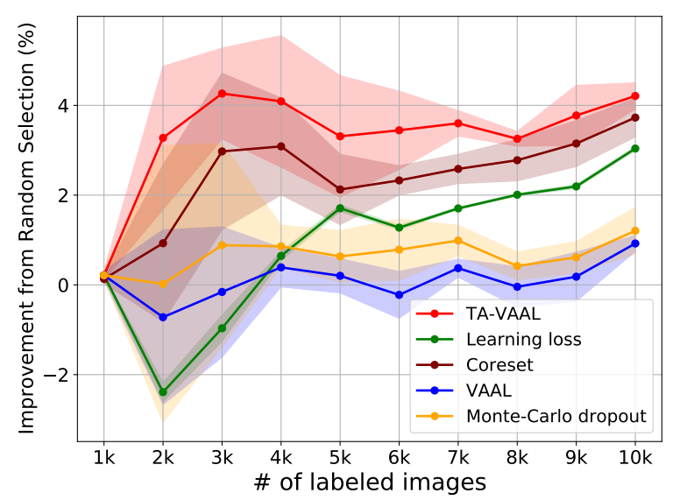
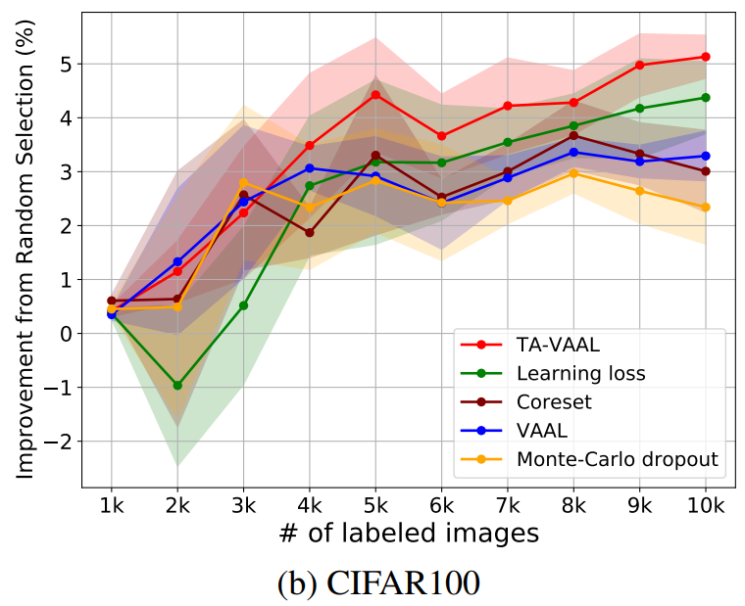
Experiments
Image classification on balanced datasets

Slide 12
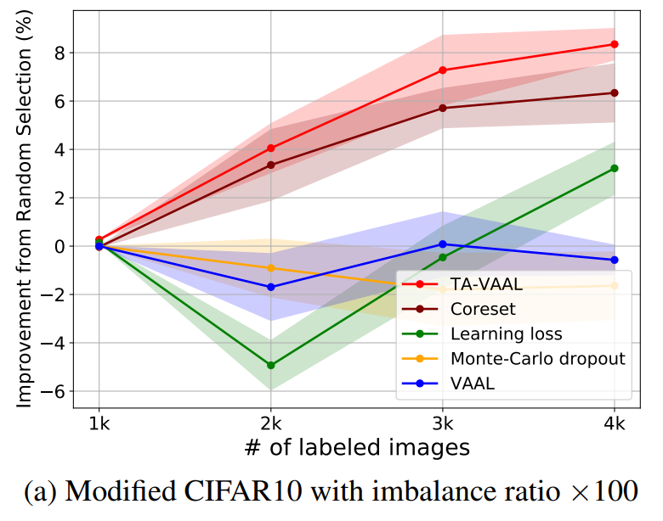
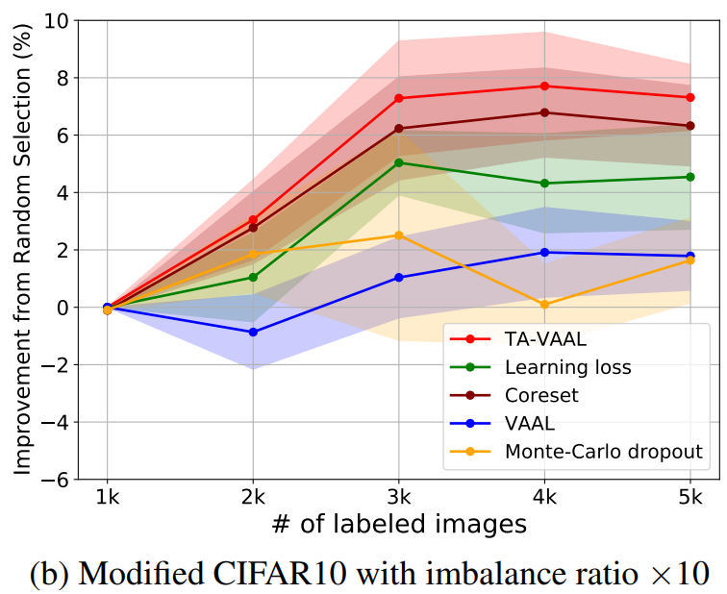
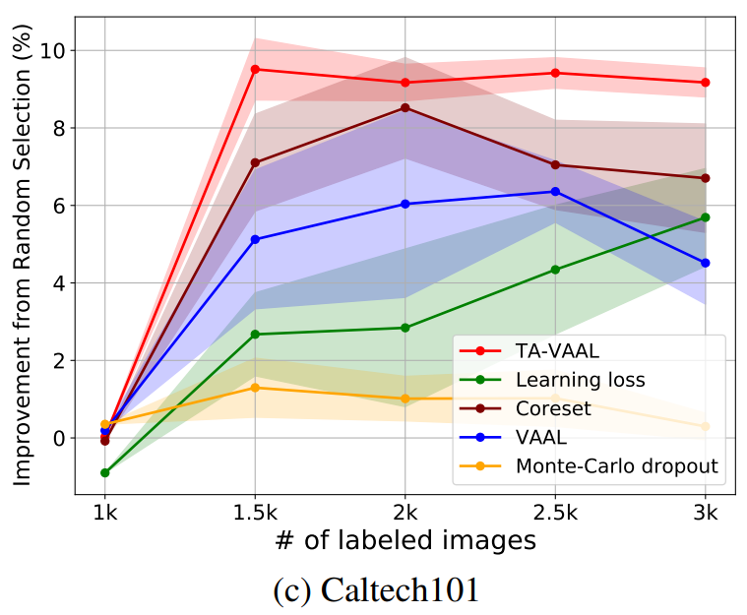
Experiments
Classification on imbalanced data

Slide 13
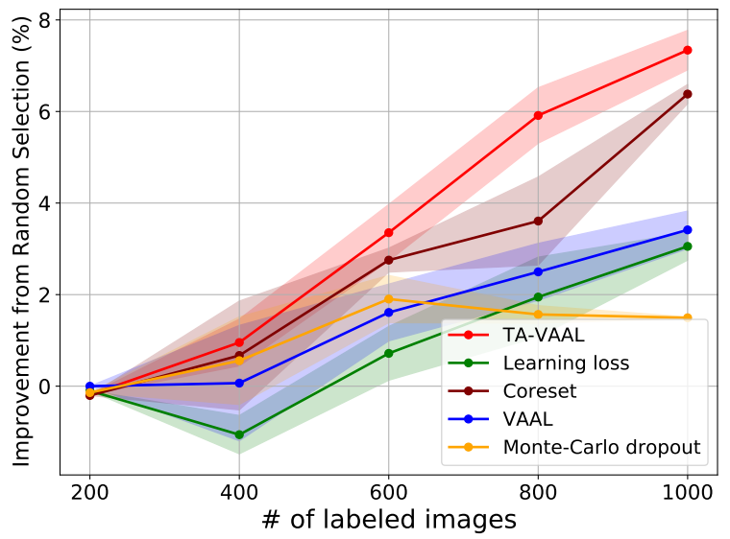
Experiments
Semantic segmentation on Cityscapes

Slide 14
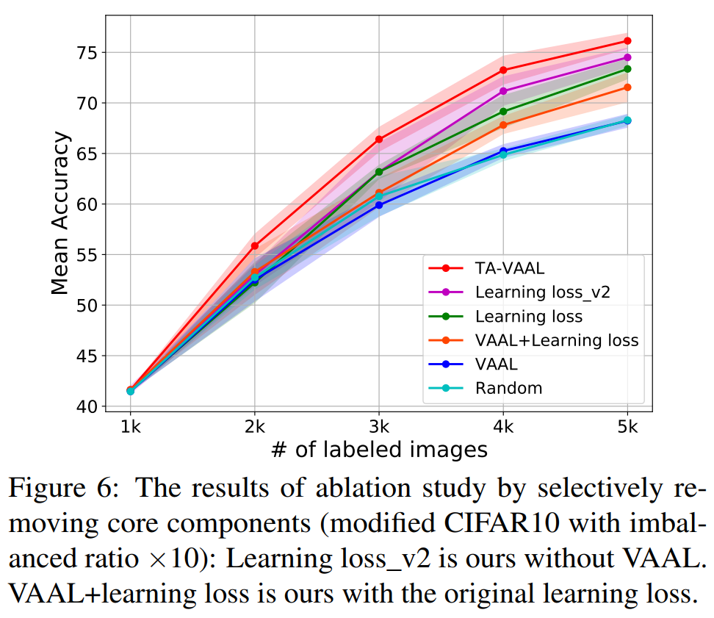
Experiments
Ablation study

Slide 15
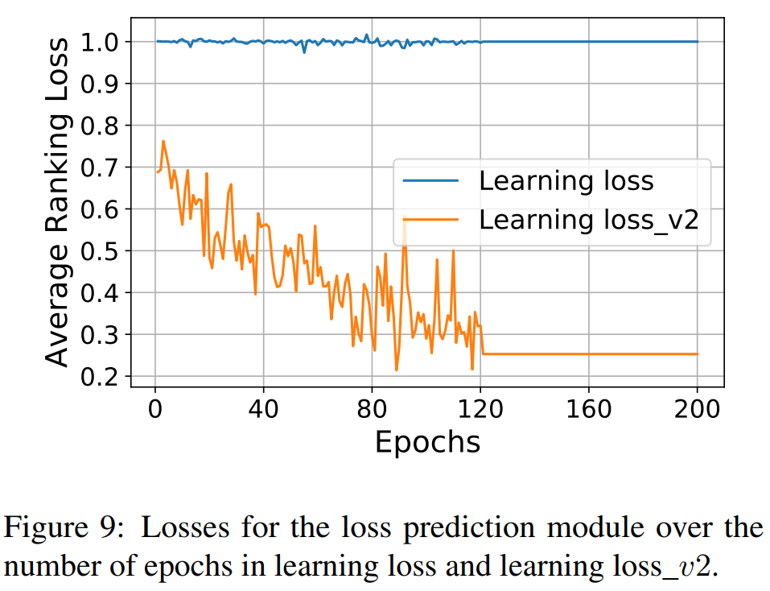
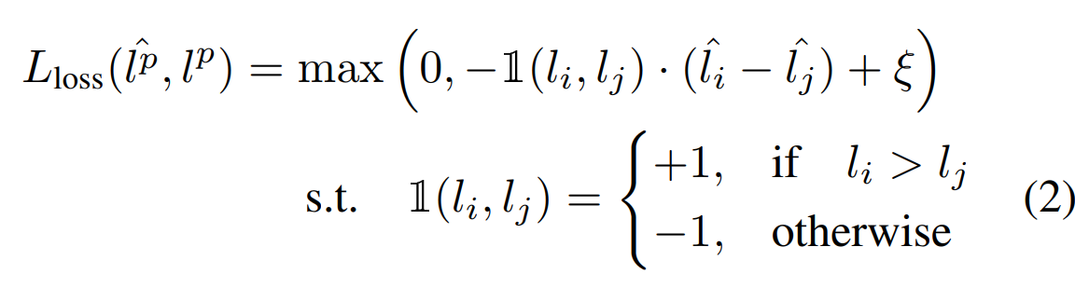
Experiment
Accurate and ranking loss

Slide 16
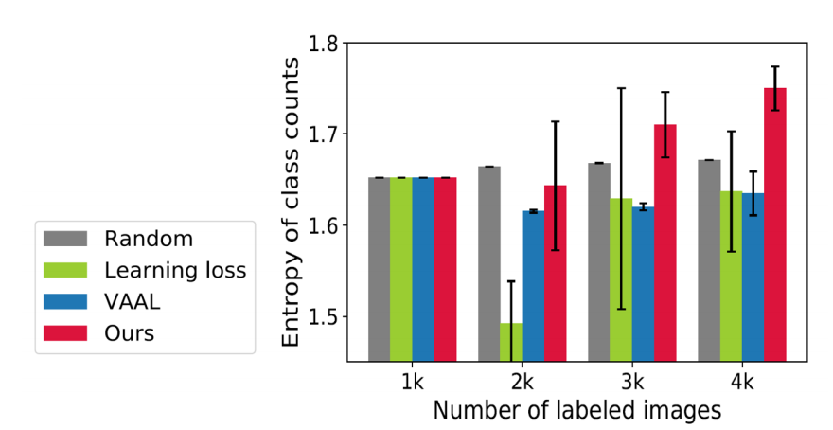
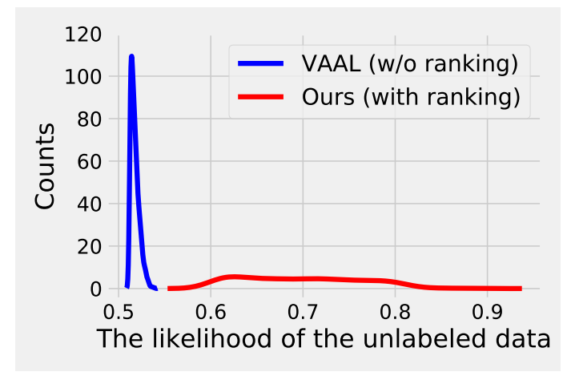
Experiments
How about the selected samples?

Slide 17
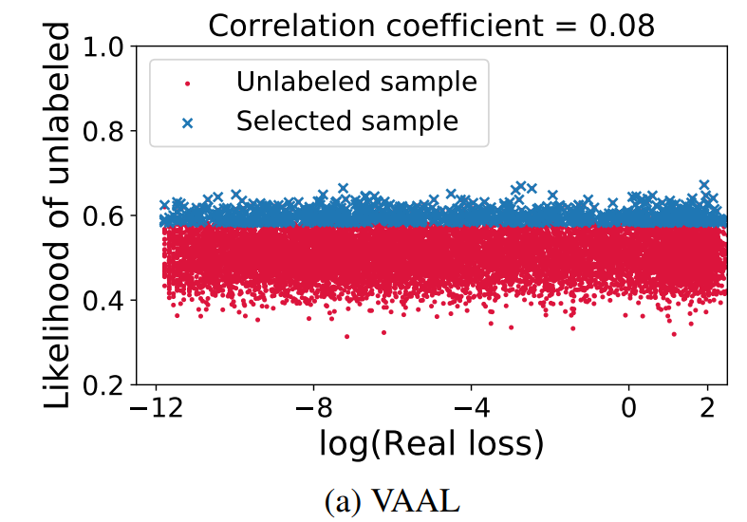
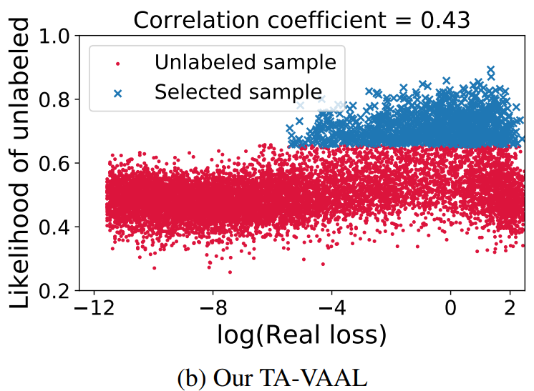
Experiments
Look at the selected data.

Slide 18
Conclusion
Combine task-agnostic and task-aware.
Task-agnostic: VAE and GAN
Task-aware: predict loss and rank them.
Use tags for methods.

Slide 19
About presentation
The sequence of slides.
Picture is better than words.
Logic is very important. It is highly related with our time duration.
Eye contact with audience.
How to read an equation?
How to explain the equations?
How to explain the results or comparison (pictures and tables).
How to write our papers?

Slide 20
Outline
Proposed
Algorithm
Conclusions
Introduction
Experiments

Slide 21
Introduction

Slide 22
Proposed Algorithm

Slide 23
Experiments

Slide 24
Conclusions

